Slide 1
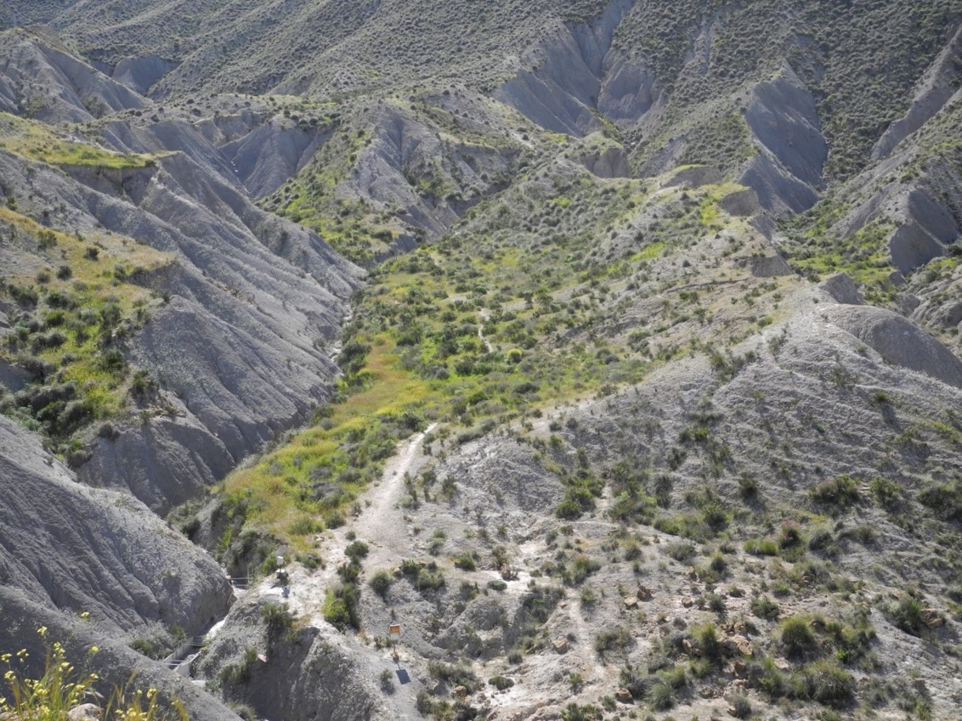

Slide 2
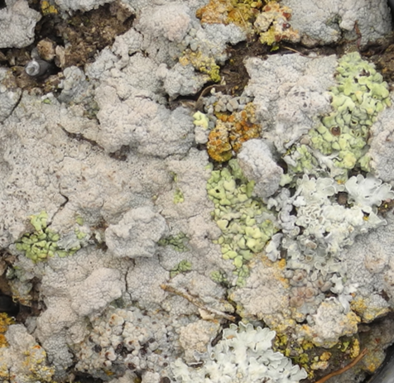

Slide 3
I want to shift my skills towards programming using different languages so I can work later on more neurotechnological projects.
how to analyze bibliometrics for literature analysis.
anova and statistical tests
… maybe RNA sequencing analysis
Data visualization with R
General data analysis,
data importing, …
… formatting my data smartly …
hope this course would help me to reduce my fear. ;)

Slide 4
What happens when cyanobacteria cells acclimate to far-red light conditions for photosynthesis?
What is the neural basis of individual variability in visual and non-visual behavior?
Biophysical characterization of membrane proteins
Microbiology and Immunology
colloidal chemistry
How are affective systems and their inter-individual variability associated with variability in the processing of emotionally and motivationally relevant stimuli in the brain?
dissecting the innate lymphoid cells in skin
How does fasting affect the inflammation in Multiple Sclerosis
psychology
Is there a plant immunity receptor network at the endoplasmatic reticulum?
What is the phylogenetic relationship between Central and South American species?
Identification of immune regulators with altered nuclear retention in Arabidopsis thaliana
How do raccoons adapt to the urban structure?

Slide 5
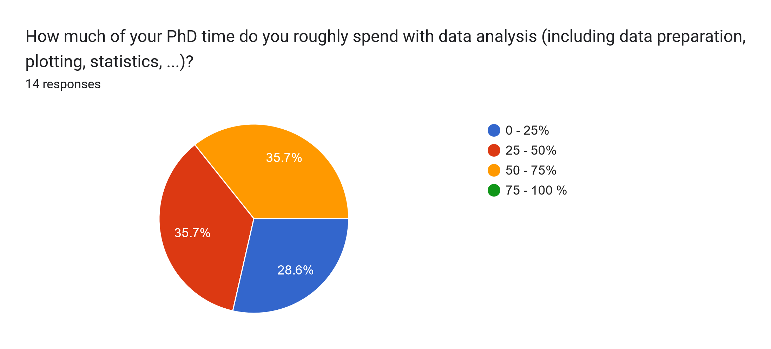

Slide 6
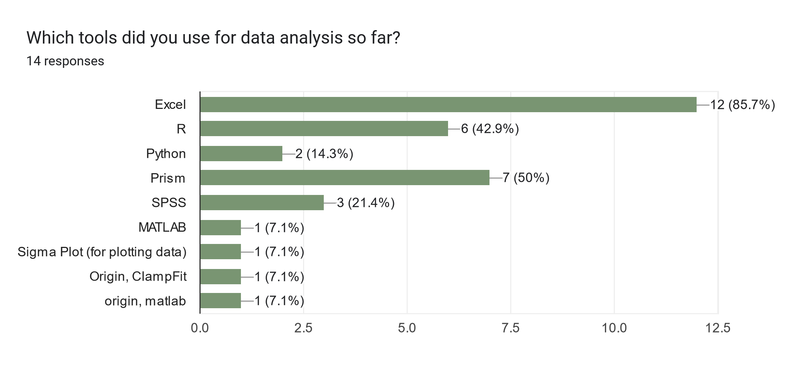

Slide 7
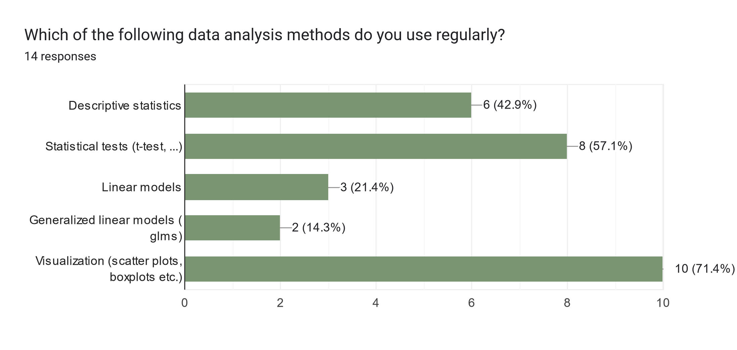

Slide 8
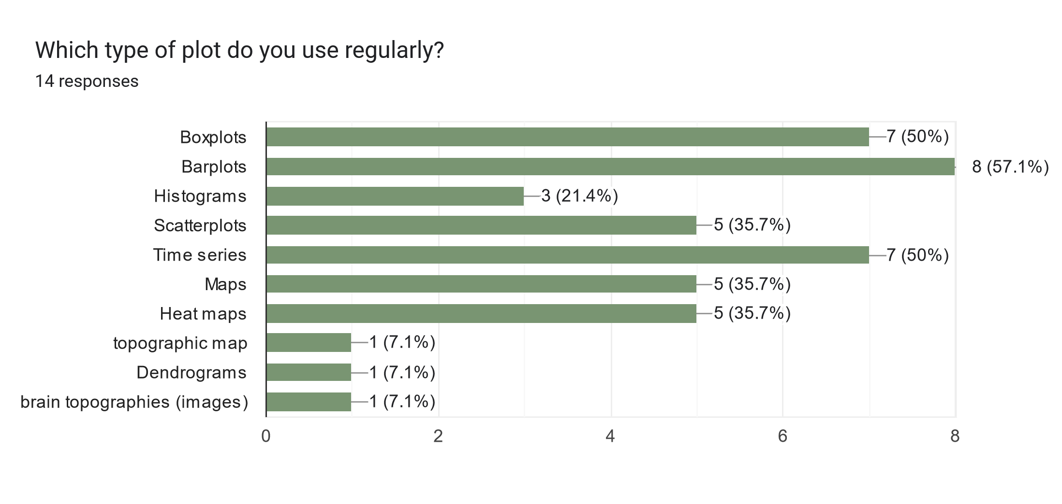

Slide 9
Visualize
R basics
Import
Tidy
Transform
Communicate
Stats
Data analysis workflow

Slide 10
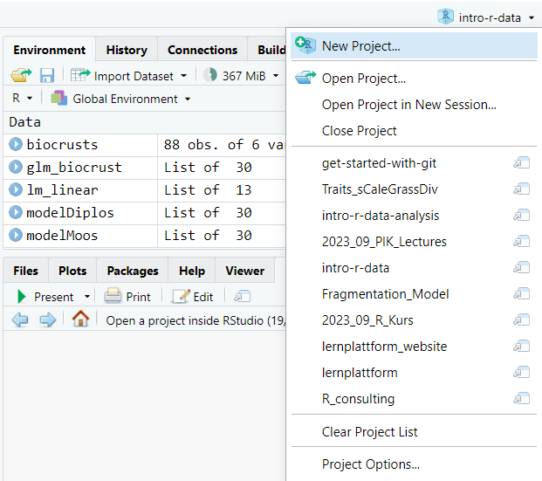

Slide 11
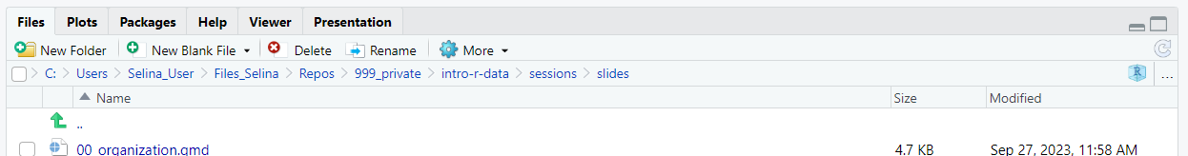
Project path
Go to project root
Open project in file explorer
Navigate one level up

Slide 12
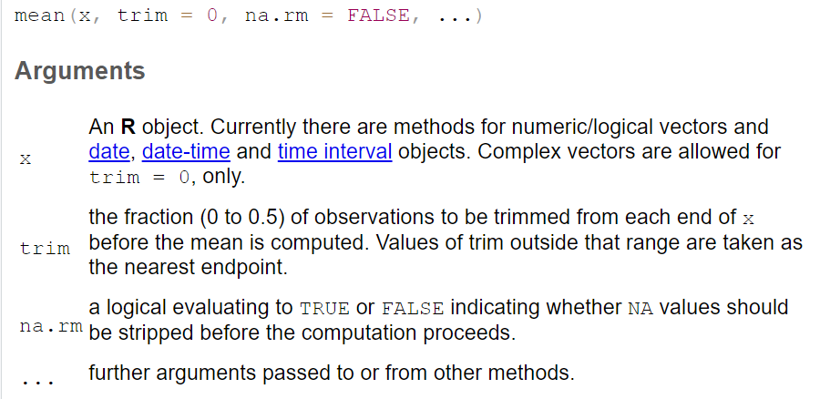

Slide 13
Function name
Input
Processing
Output
Side effects

Slide 14
mean
c(1, 5, 6)
Add values and divide by the length of the vector
4

Slide 15
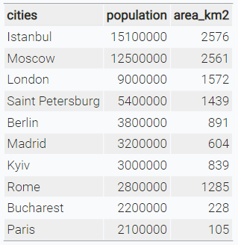
character
numeric

Slide 16





Visualize
R basics
Import
Tidy
Transform
Communicate
Model
Data analysis workflow

Slide 17

Data structure
Import
Tidy
Transform
Visualise

Slide 18
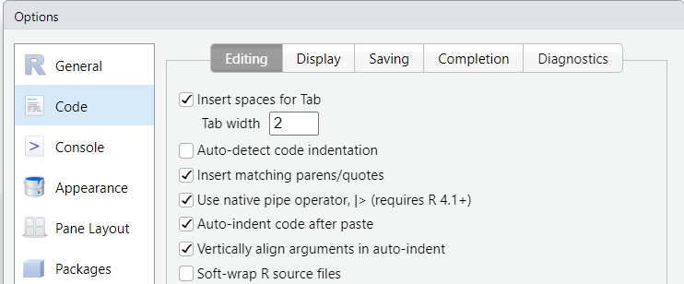

Slide 19
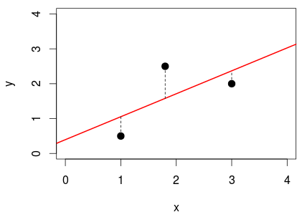

Slide 20
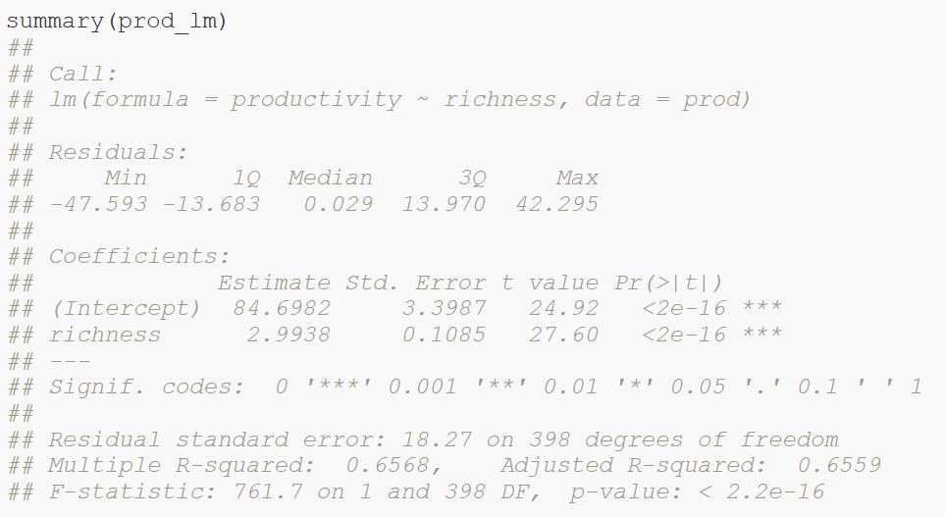
Calculated model
Distribution of residuals (errors)

Slide 21
Model coefficients:
Intercept = 84.7
Slope = 3
Standard error of coefficients

Slide 22
t-statistics: ratio of coefficients to their standard error

Slide 23
Coefficient of determination R²

Slide 24
F statistics: ratio of explained variance compared to null model

Slide 25
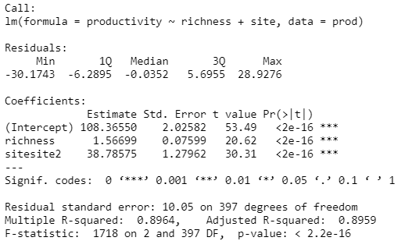
Intercept site1 = 108.4
Slope = 1.6
Intercept site2 = 108.4 + 38.8

Slide 26
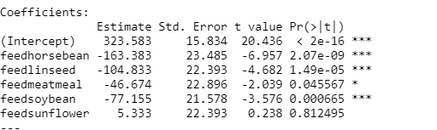
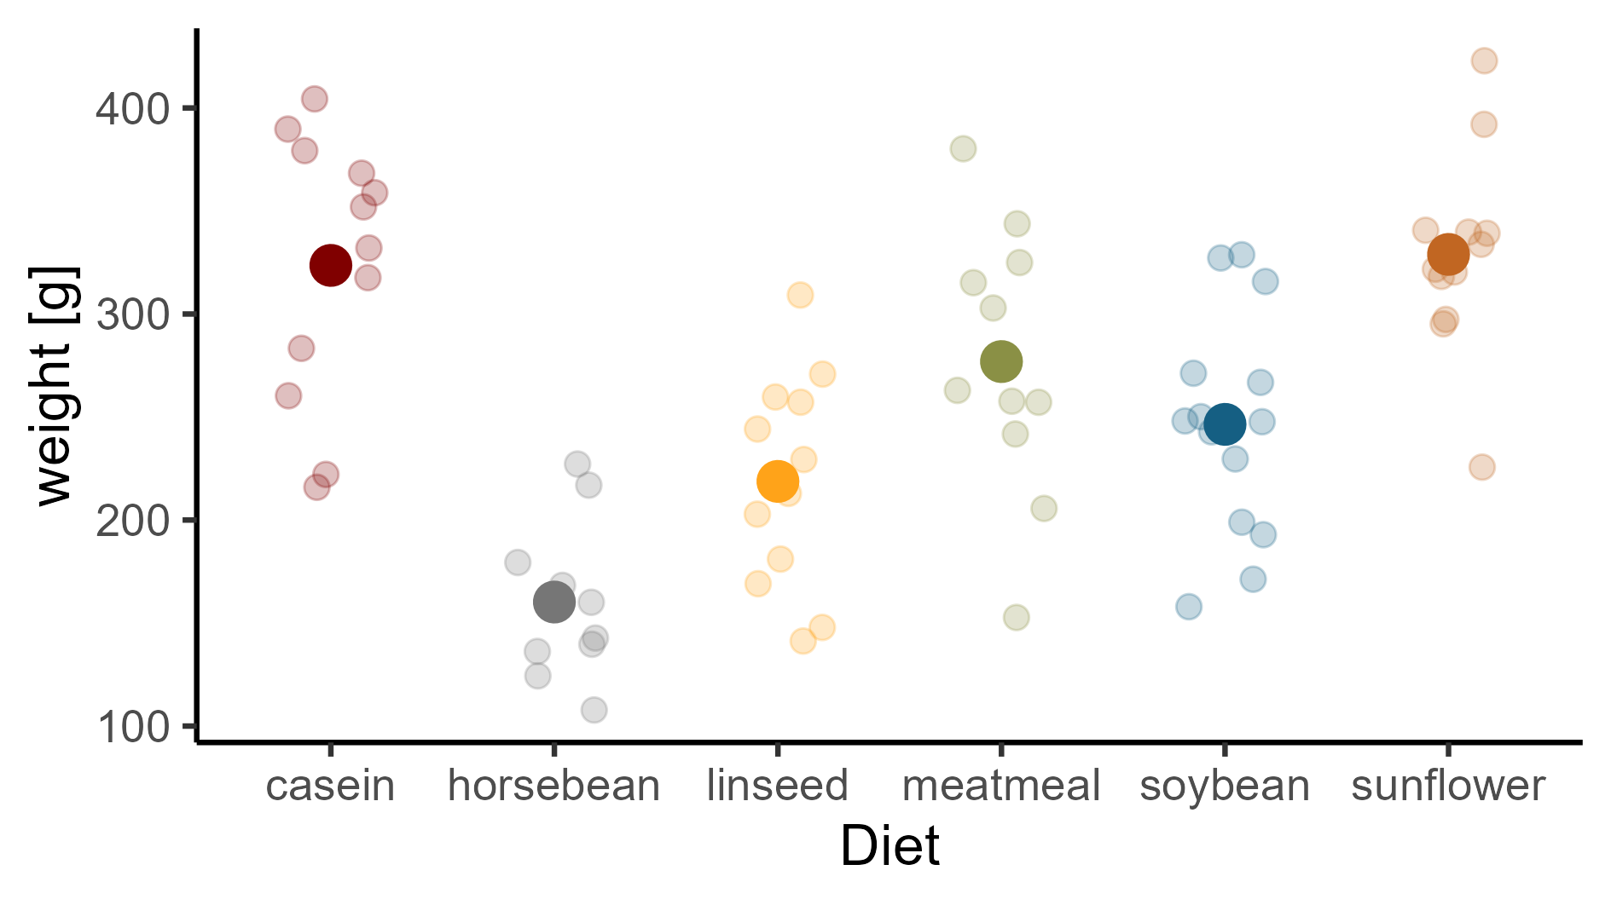

Slide 27
(Intercept) + feedlinseed
(Intercept) + feedsoybean
(Intercept)
(Intercept) + feedsunflower
(Intercept) + feedhorsebean
(Intercept) + feedmeatmeal

Slide 28
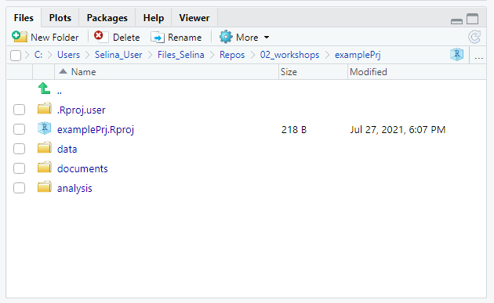
Navigate to project root
Project path
Navigate one level up
Open project in file explorer

Slide 29
Visualize
Import
Tidy
Transform
Communicate
Model
Understand

Slide 30
y
No interaction
y
Interaction
x₁
X₂
a
b
x₁

Slide 31




Slide 32
normal
distribution?
Kolmogorov-Smirnov-test, QQ-test, Shapiro-Wilk-test,..
yes
equal
variance?
F-test
no
yes
no
equal
mean?
t-test
Welch-
test
Wilcoxon-rank- sum-test
Note:
Levine-test not necessary, if you are interested
in equal means, but not equal variances!

Slide 33
Truth
H0 is true
H0 is false
Correct decision
Probability: 1 - α
Type II error
Probability: β
Accept H0
Decision based on statistical test
Type I error
Probability: α
Correct decision
Probability: 1 – β
(Power)
Reject H0

Slide 34


Scientific idea
working hypothesis H1
and
null hypothesis H0
p: how likely would it be to observe the data if the null hypothesis was true?
unlikely (p ≤ α):
reject H0
otherwise: not not reject H0
collect data
chose level of
significance α,
test the null
hypothesis
errors possible

Slide 35
A
B
joined and sorted

Slide 36
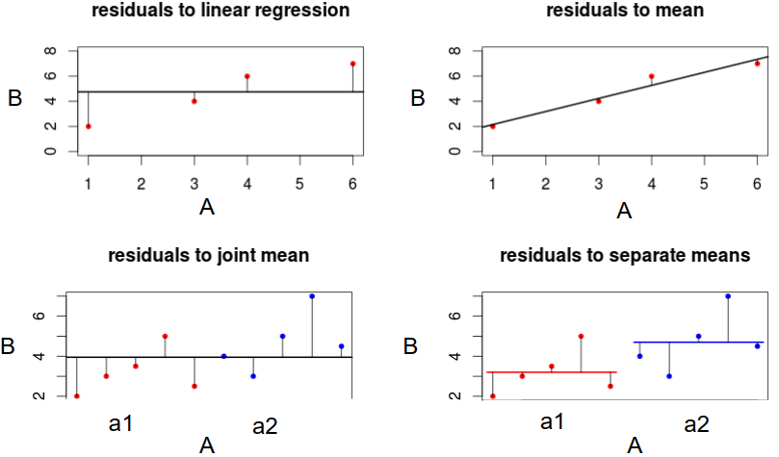
Residuals to mean
Residuals to regression line
Residuals to joint mean
Residuals to separate means

